Slide 1


<Name>
<Date>

Slide 2

Outline
Executive Summary
Introduction
Methodology
Results
Conclusion
Appendix

Slide 3
Executive Summary
Summary of methodologies
Data Collection through API
Data Collection with Web Scraping
Data Wrangling
Exploratory Data Analysis with SQL
Exploratory Data Analysis with Data Visualization
Interactive Visual Analytics with Folium
Machine Learning Prediction
Summary of all results
Exploratory Data Analysis result
Interactive analytics in screenshots
Predictive Analytics result

Slide 4
Introduction
Project background and context
SpaceX advertises Falcon 9 rocket launches at a cost of $62 million, while other providers charge upwards of $165 million per launch. Much of SpaceX’s savings come from reusing the first stage of the rocket. Therefore, if we can predict whether the first stage will land successfully, we can estimate the cost of a launch. This information could be useful for another company looking to compete with SpaceX for a rocket launch bid. The goal of this project is to develop a machine learning pipeline to predict the successful landing of the first stage.
Problems you want to find answers
What factors influence whether the rocket will land successfully?
The interaction between various features that impact the likelihood of a successful landing.
The specific operating conditions required to ensure a successful landing program.

Slide 5

Section 1

Slide 6
Methodology
Executive Summary
Data collection methodology:
SpaceX API and Web scraping
Perform data wrangling
Summarize and analyze features
Perform exploratory data analysis (EDA) using visualization and SQL
Perform interactive visual analytics using Folium and Plotly Dash
Perform predictive analysis using classification models
Data is normalized and divided to training and test sets. Different models were used and compared with variations of parameters

Slide 7
Data Collection
Describe how data sets were collected.
Datasets were pulled from Space X API and Web-scraped from Wikipedia

Slide 8
Data Collection – SpaceX API
SpaceX provides a public API that allows data retrieval, which is then processed following the steps outlined in the accompanying flowchart, and the data is stored afterward
https://github.com/teetri/ibm-data-science-coursera/blob/main/Capstone/jupyter-labs-spacex-data-collection-api.ipynb
Request API and parse SpaceX launch data
Filter data to only have Falcon 9 launches
Deal with missing values

Slide 9
Data Collection - Scraping
Launch data from SpaceX can also be sourced from Wikipedia. Following the steps in the flowchart, the data is downloaded from Wikipedia and stored for future use
https://github.com/teetri/ibm-data-science-coursera/blob/main/Capstone/jupyter-labs-webscraping.ipynb
Request Falcon 9 Launches Wikipedia page
Extract all column and variable names from html table header
Create dataframer by parsing the html data

Slide 10
Data Wrangling
An initial Exploratory Data Analysis (EDA) was conducted on the dataset. • A summary of launches per site, occurrences of each orbit, and mission outcomes per orbit type was calculated. • Lastly, the landing outcome label was generated from the Outcome column.
https://github.com/teetri/ibm-data-science-coursera/blob/main/Capstone/labs-jupyter-spacex-Data%20wrangling.ipynb
EDA
Summarization
New column: Outcome

Slide 11
EDA with Data Visualization
To explore data, scatterplots and bar plots were used to visualize the relationship between pair of features: Payload Mass X Flight Number, Launch Site X Flight Number, Launch Site X Payload Mass, Orbit and Flight Number, Payload and Orbit
https://github.com/teetri/ibm-data-science-coursera/blob/main/Capstone/edadataviz.ipynb

Slide 12
EDA with SQL
The following SQL queries were executed: • List of unique launch site names in space missions. • Top 5 launch sites starting with 'CCA'. • Total payload mass carried by boosters launched by NASA (CRS). • Average payload mass carried by the booster version F9 v1.1. • Date of the first successful landing outcome on a ground pad. • Boosters that successfully landed on a drone ship with payloads between 4000 and 6000 kg. • Total count of successful and failed mission outcomes. • Booster versions that carried the maximum payload mass. • Failed landing outcomes on drone ships in 2015, along with their booster versions and launch sites. • Ranking of landing outcomes (e.g., Failure on droneship or Success on ground pad) between June 4, 2010, and March 20, 2017.
https://github.com/teetri/ibm-data-science-coursera/blob/main/Capstone/jupyter-labs-eda-sql-coursera_sqllite.ipynb

Slide 13
Build an Interactive Map with Folium
Folium Maps utilized markers, circles, lines, and marker clusters: • Markers were used to represent locations, such as launch sites. • Circles highlighted areas around specific coordinates, like the NASA Johnson Space Center. • Marker clusters grouped events occurring at the same location, such as multiple launches from a launch site. • Lines connected coordinates to show distances between two points.
https://github.com/teetri/ibm-data-science-coursera/blob/main/Capstone/lab_jupyter_launch_site_location.ipynb

Slide 14
Build a Dashboard with Plotly Dash
developed an interactive dashboard using Plotly Dash: • Pie charts were created to display the total number of launches at specific sites. • A scatter plot was used to illustrate the relationship between Outcome and Payload Mass (Kg) across different booster versions.
https://github.com/teetri/ibm-data-science-coursera/blob/main/Capstone/spacex_dash_app.py

Slide 15
Predictive Analysis (Classification)
We loaded the data using NumPy and Pandas, transformed it, and then split it into training and testing sets. • Various machine learning models were built and hyperparameters were tuned using GridSearchCV. • Accuracy was used as the performance metric, and the model was refined through feature engineering and algorithm adjustments. • The best-performing classification model was identified.
https://github.com/teetri/ibm-data-science-coursera/blob/main/Capstone/SpaceX_Machine%20Learning%20Prediction_Part_5.ipynb

Slide 16
Results
Exploratory Data Analysis results: • SpaceX operates from 4 distinct launch sites. • The initial launches were conducted for SpaceX itself and NASA. • The average payload for the F9 v1.1 booster is 2,928 kg. • The first successful landing outcome occurred in 2015, five years after the first launch. • Several Falcon 9 booster versions succeeded in landing on drone ships with payloads above the average. • Nearly 100% of mission outcomes were successful. • In 2015, two booster versions, F9 v1.1 B1012 and F9 v1.1 B1015, failed to land on drone ships. • Landing outcomes improved over the years.

Slide 17

Section 2

Slide 18
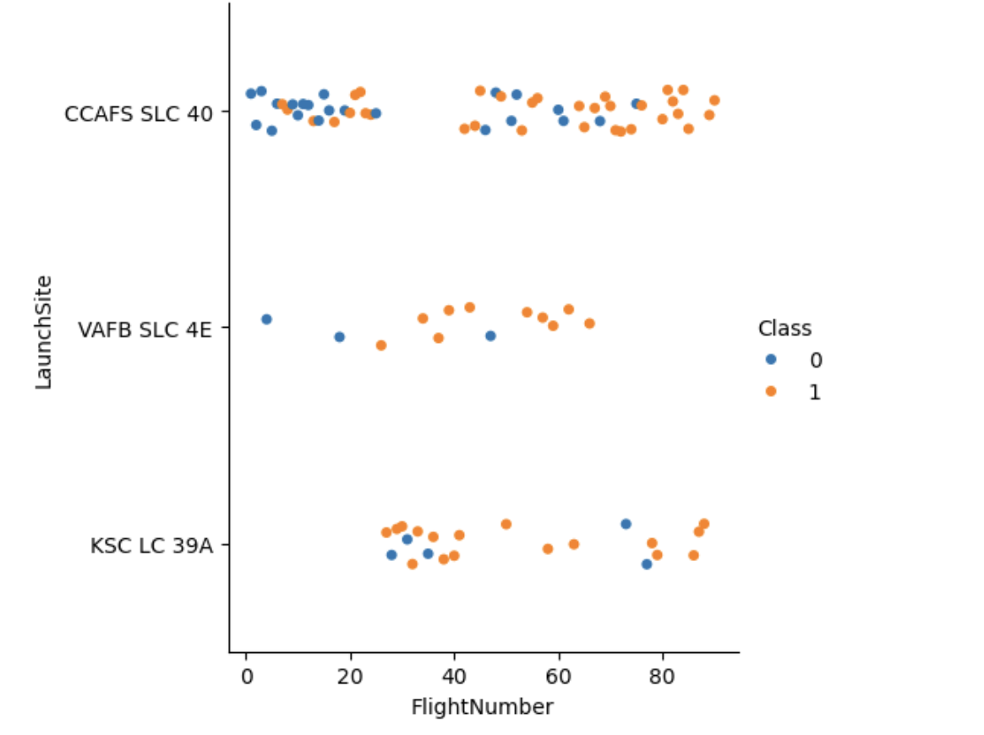
Flight Number vs. Launch Site
The plot revealed that a higher number of flights at a launch site is associated with a greater success rate at that site.

Slide 19
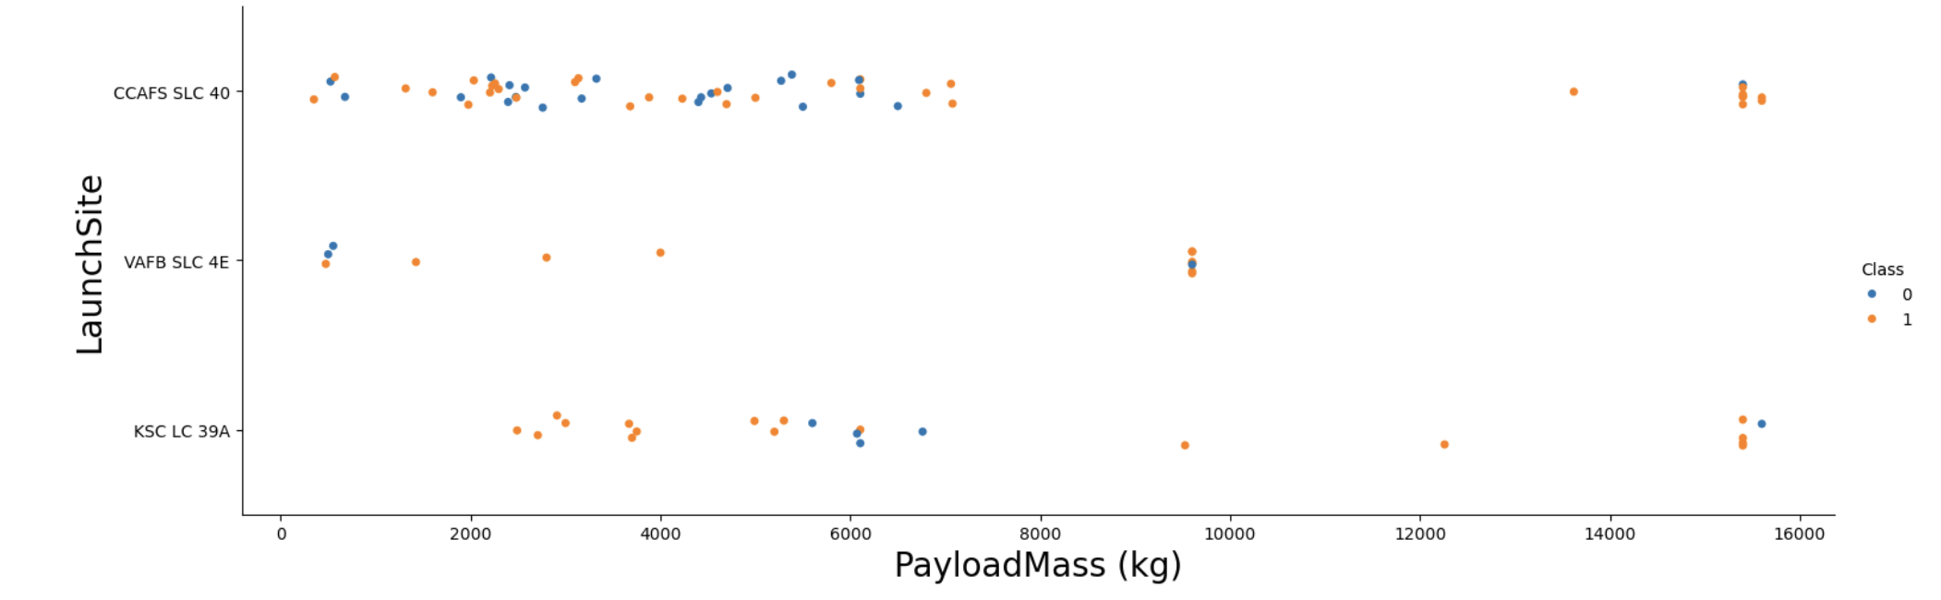
Payload vs. Launch Site

Slide 20
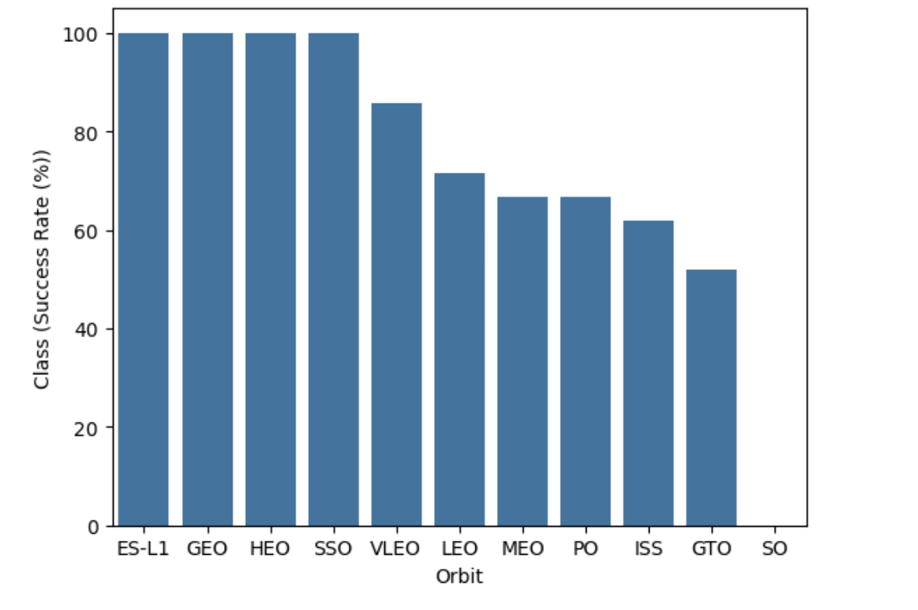
Success Rate vs. Orbit Type
From the plot, we can see that ES-L1, GEO, HEO, SSO, VLEO had the most success rate.

Slide 21
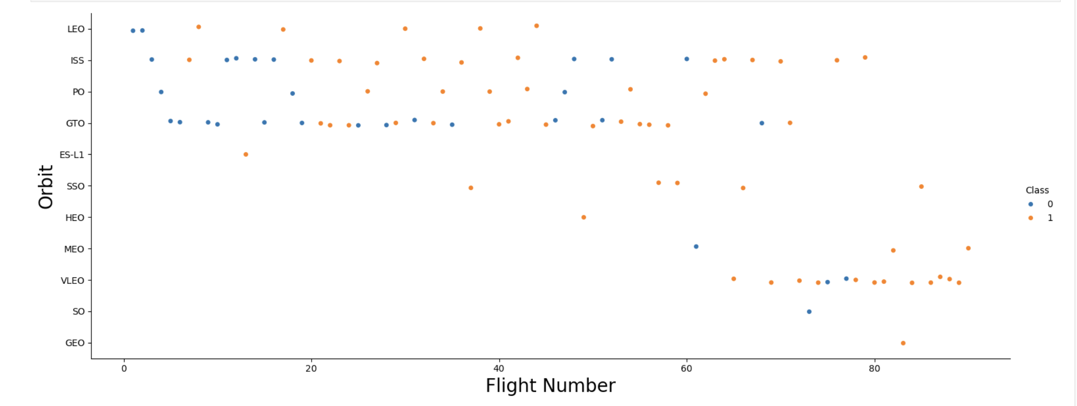
Flight Number vs. Orbit Type
The plot below displays Flight Number versus Orbit Type. It shows that for the LEO orbit, success is correlated with the number of flights, whereas for the GTO orbit, there is no discernible relationship between flight number and succes

Slide 22
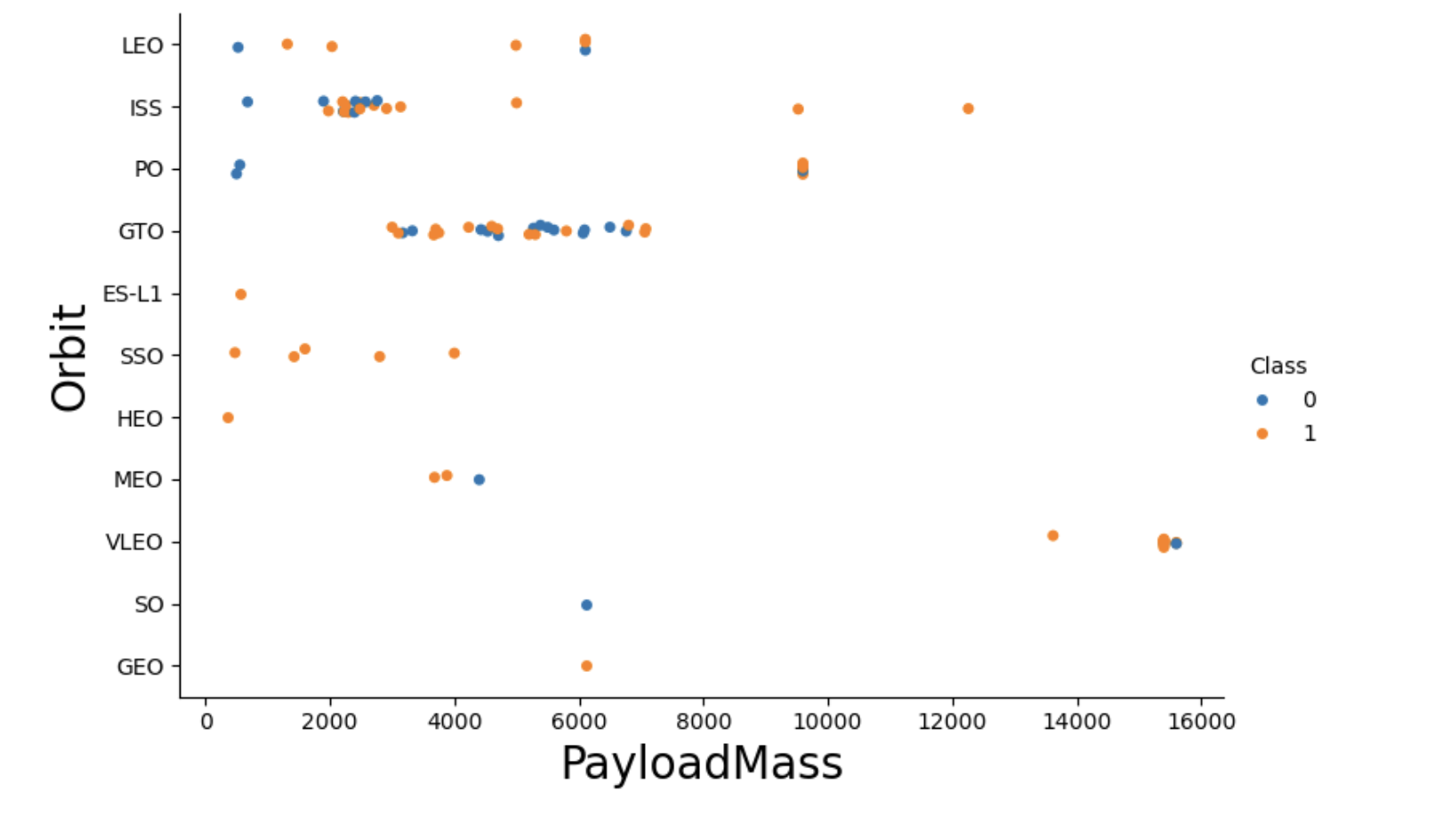
Payload vs. Orbit Type
It is observed that heavier payloads are associated with a higher rate of successful landings for PO, LEO, and ISS orbits.

Slide 23
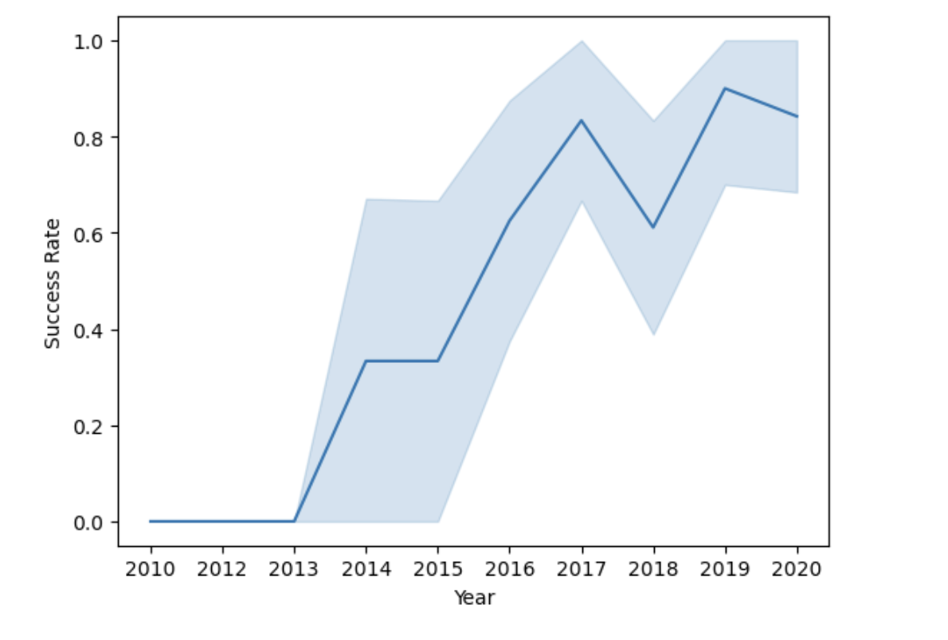
Launch Success Yearly Trend
The plot shows that the success rate has been steadily increasing from 2013 up to 2020.

Slide 24
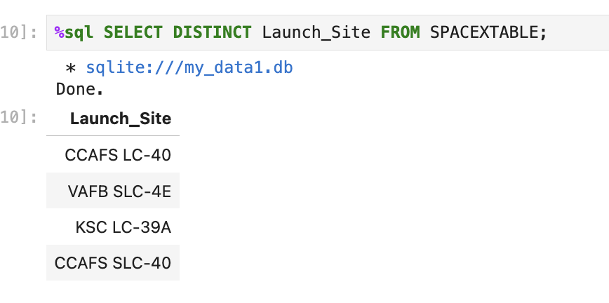
All Launch Site Names
The keyword DISTINCT was used to display only the unique launch sites from the SpaceX data.

Slide 25
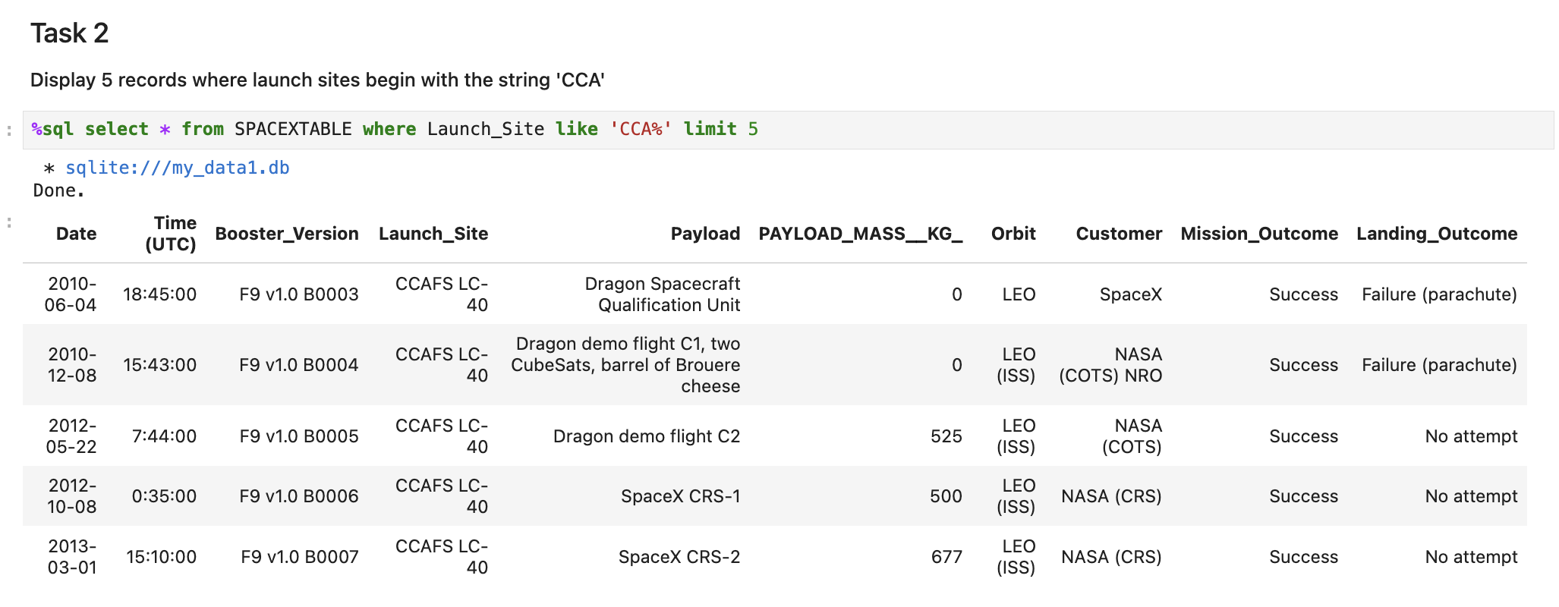
Launch Site Names Begin with 'CCA'
The query was used to retrieve 5 records where the launch sites start with CCA.

Slide 26
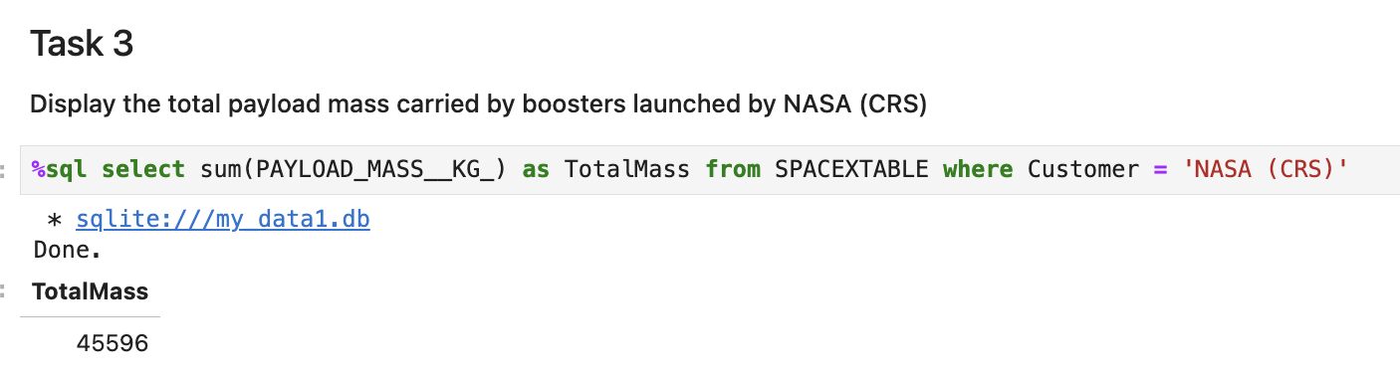
Total Payload Mass
The total payload carried by NASA boosters was calculated as 45,596 using the query provided.

Slide 27
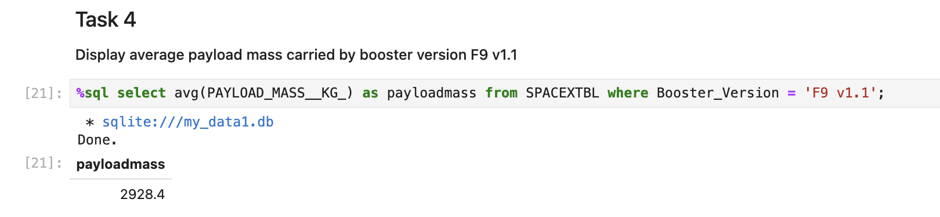
Average Payload Mass by F9 v1.1
The average payload mass for the booster version F9 v1.1 was calculated as 2,928.4 kg.

Slide 28
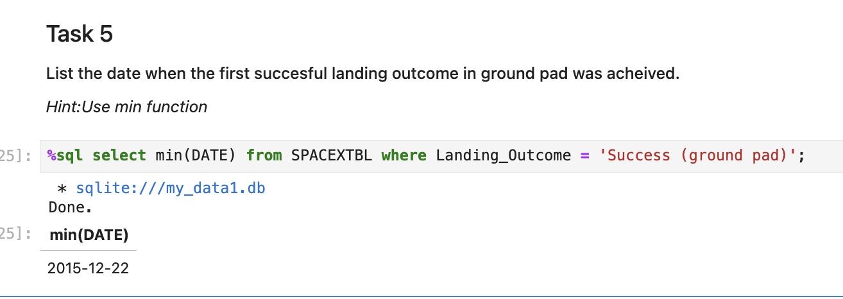
First Successful Ground Landing Date
The date of the first successful landing outcome on a ground pad was observed to be December 22, 2015.

Slide 29
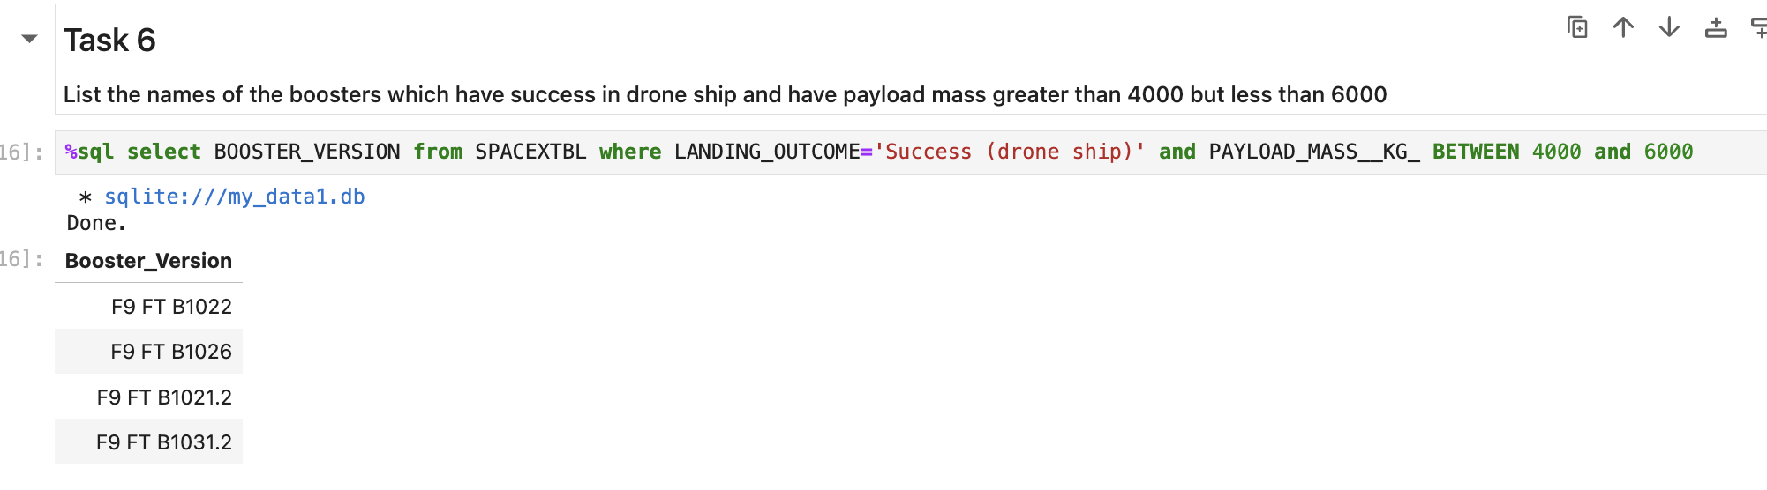
Successful Drone Ship Landing with Payload between 4000 and 6000
The WHERE clause was used to filter boosters that successfully landed on a drone ship, and the AND condition was applied to select those with a payload mass greater than 4,000 kg but less than 6,000 kg.

Slide 30
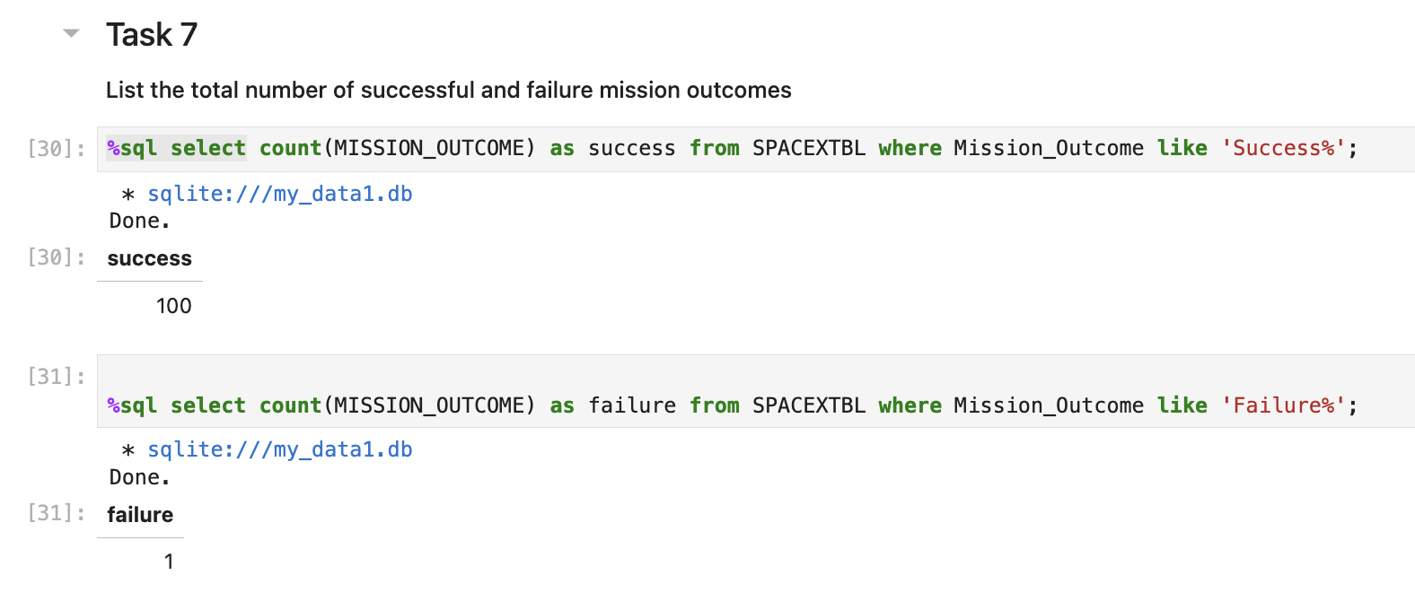
Total Number of Successful and Failure Mission Outcomes
The wildcard '%' was used in the WHERE clause to filter for records where the MissionOutcome was either a success or a failure.

Slide 31
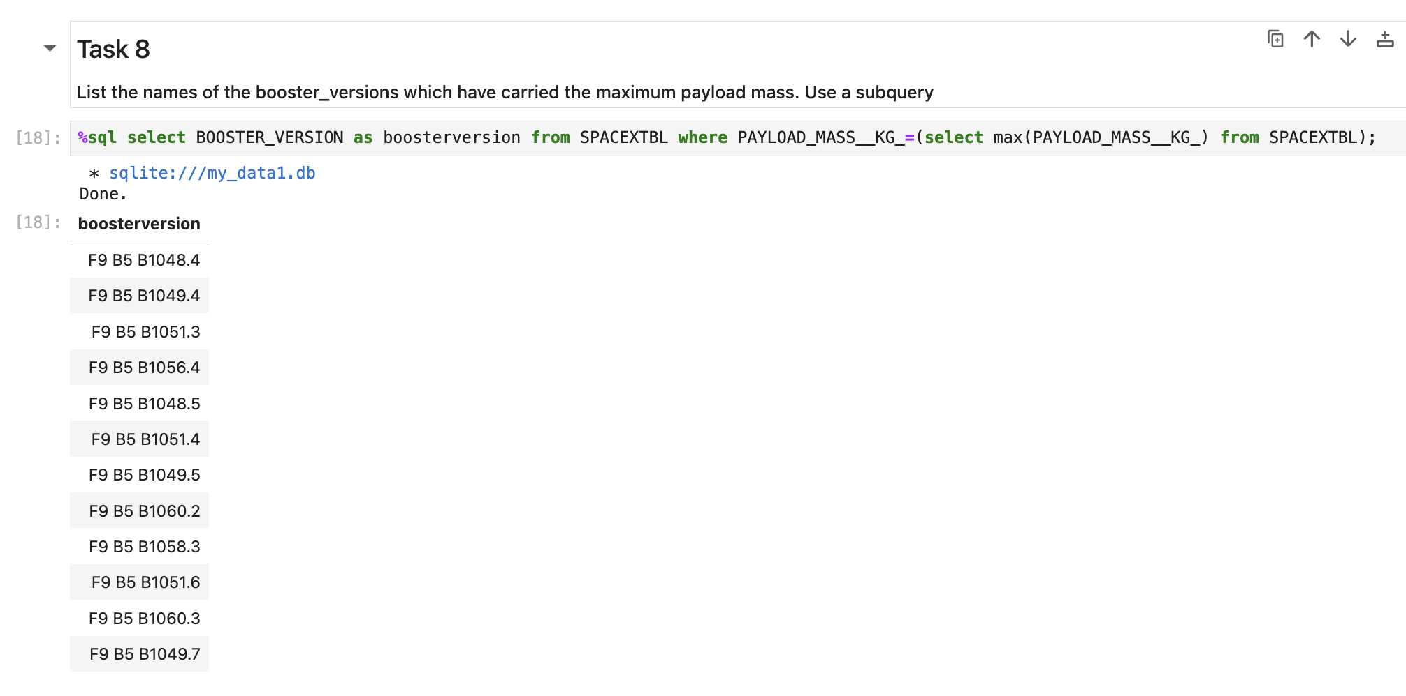
Boosters Carried Maximum Payload
We identified the booster that carried the maximum payload by using a subquery in the WHERE clause along with the MAX() function.

Slide 32
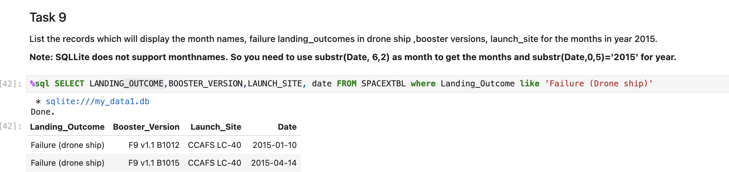
2015 Launch Records
We used a combination of the WHERE clause, LIKE, AND, and BETWEEN conditions to filter for failed landing outcomes on drone ships, along with their booster versions and launch site names for the year 2015.

Slide 33
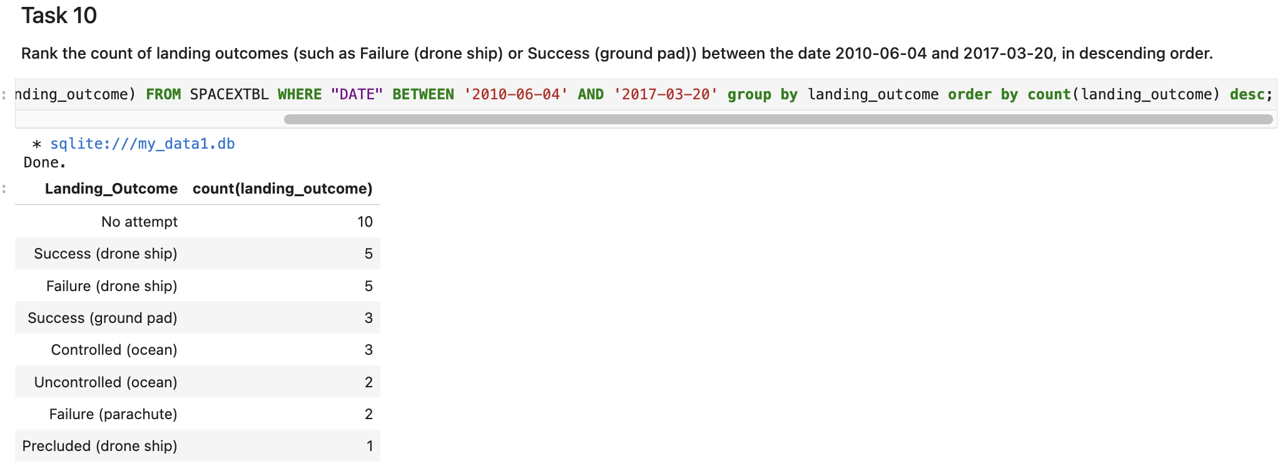
Rank Landing Outcomes Between 2010-06-04 and 2017-03-20
We selected landing outcomes and their counts from the data, using the WHERE clause to filter outcomes between June 4, 2010, and March 20, 2017.
• The GROUP BY clause was used to group the landing outcomes, and the ORDER BY clause sorted these groups in descending order.

Slide 34

Section 3

Slide 35
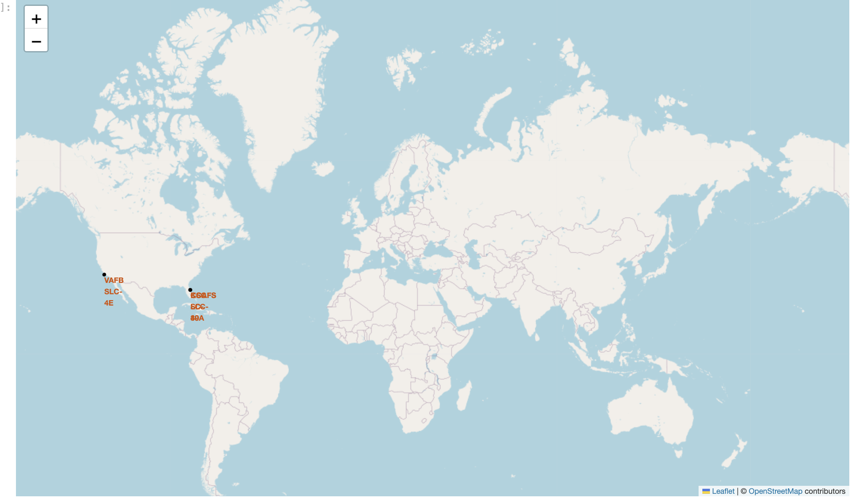
All launch site global map
All launch sites are in USA

Slide 36
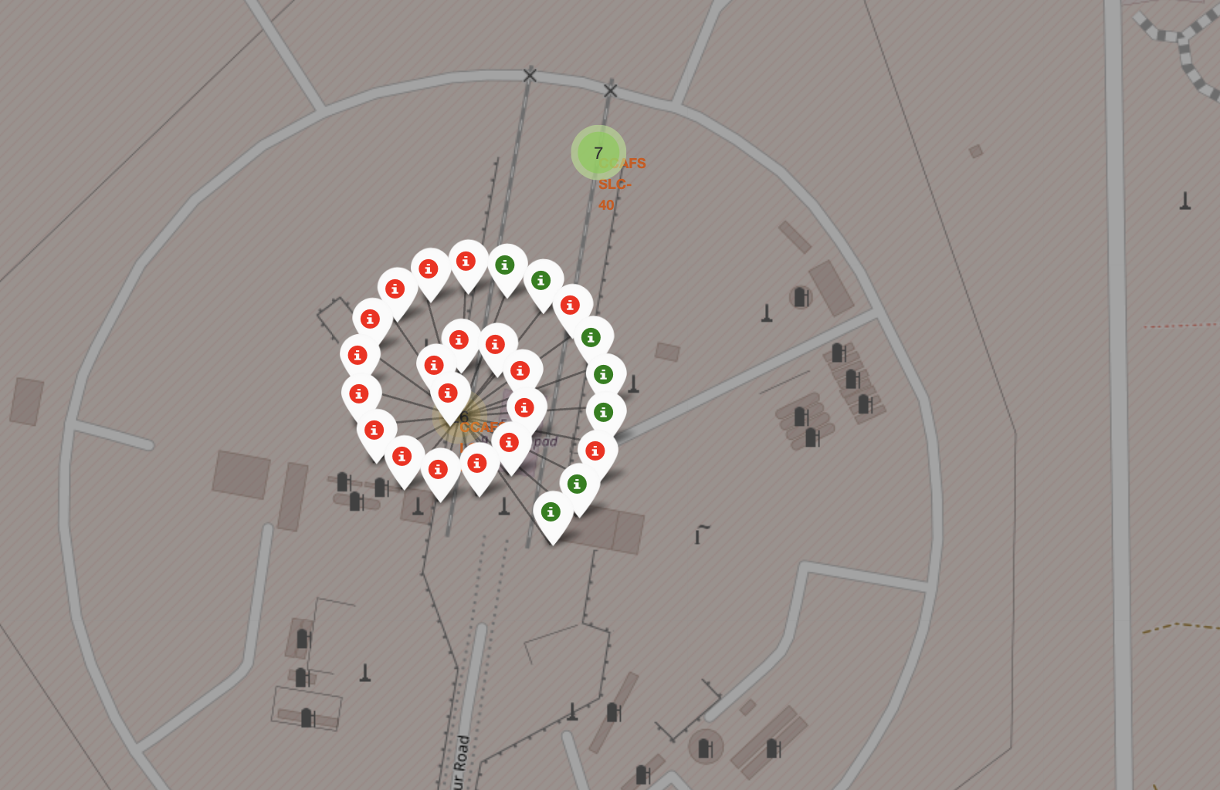
Launch sites with color labels
Green-Success Red-Failure

Slide 37
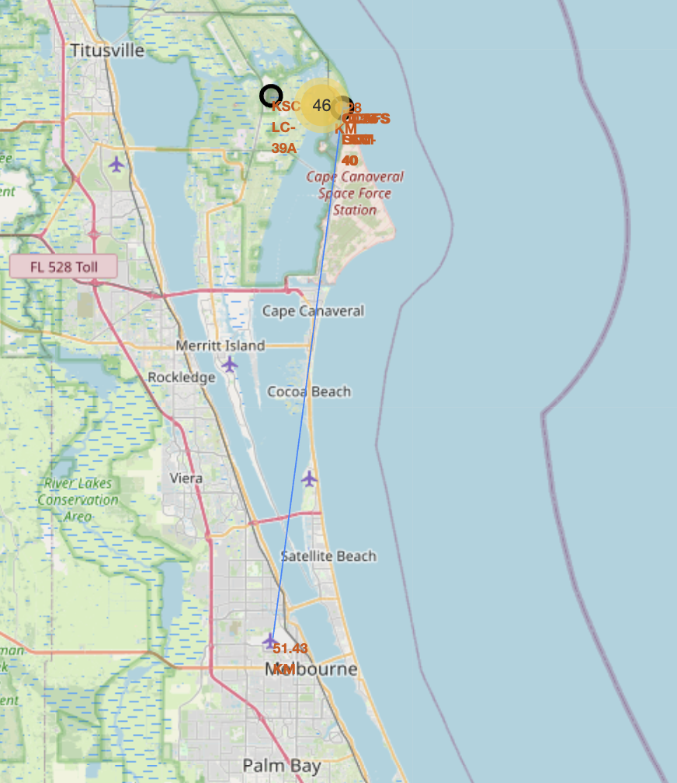
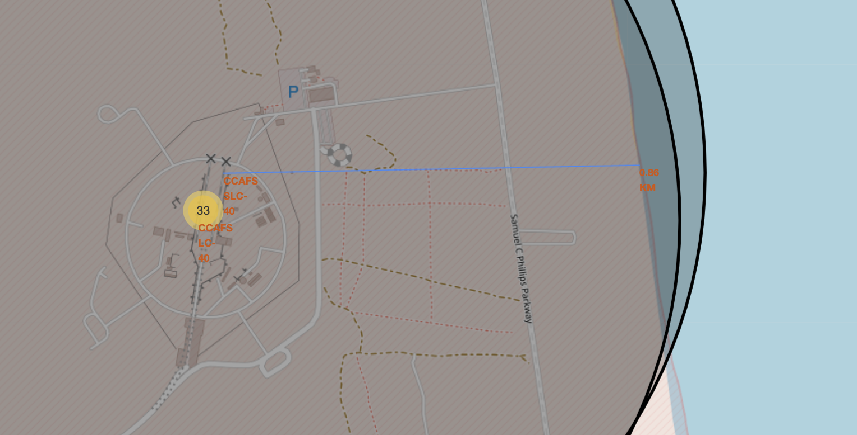
Launch sites distance to landmarks
We can see distance line from launch site to coastline, airport

Slide 38

Section 4

Slide 39
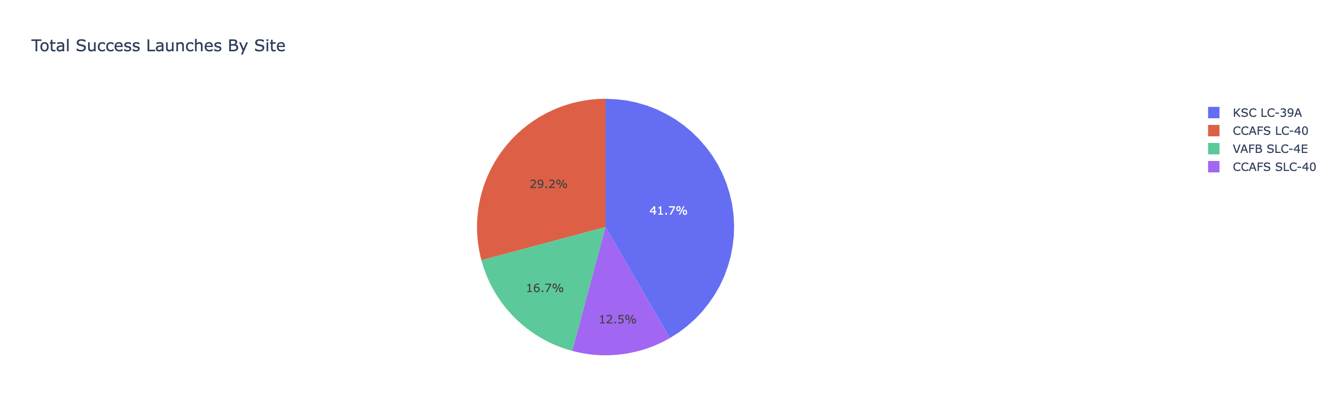
Pie chart showing the success percentage achieved by each launch site
KSC LC-29A has the most successful launch

Slide 40
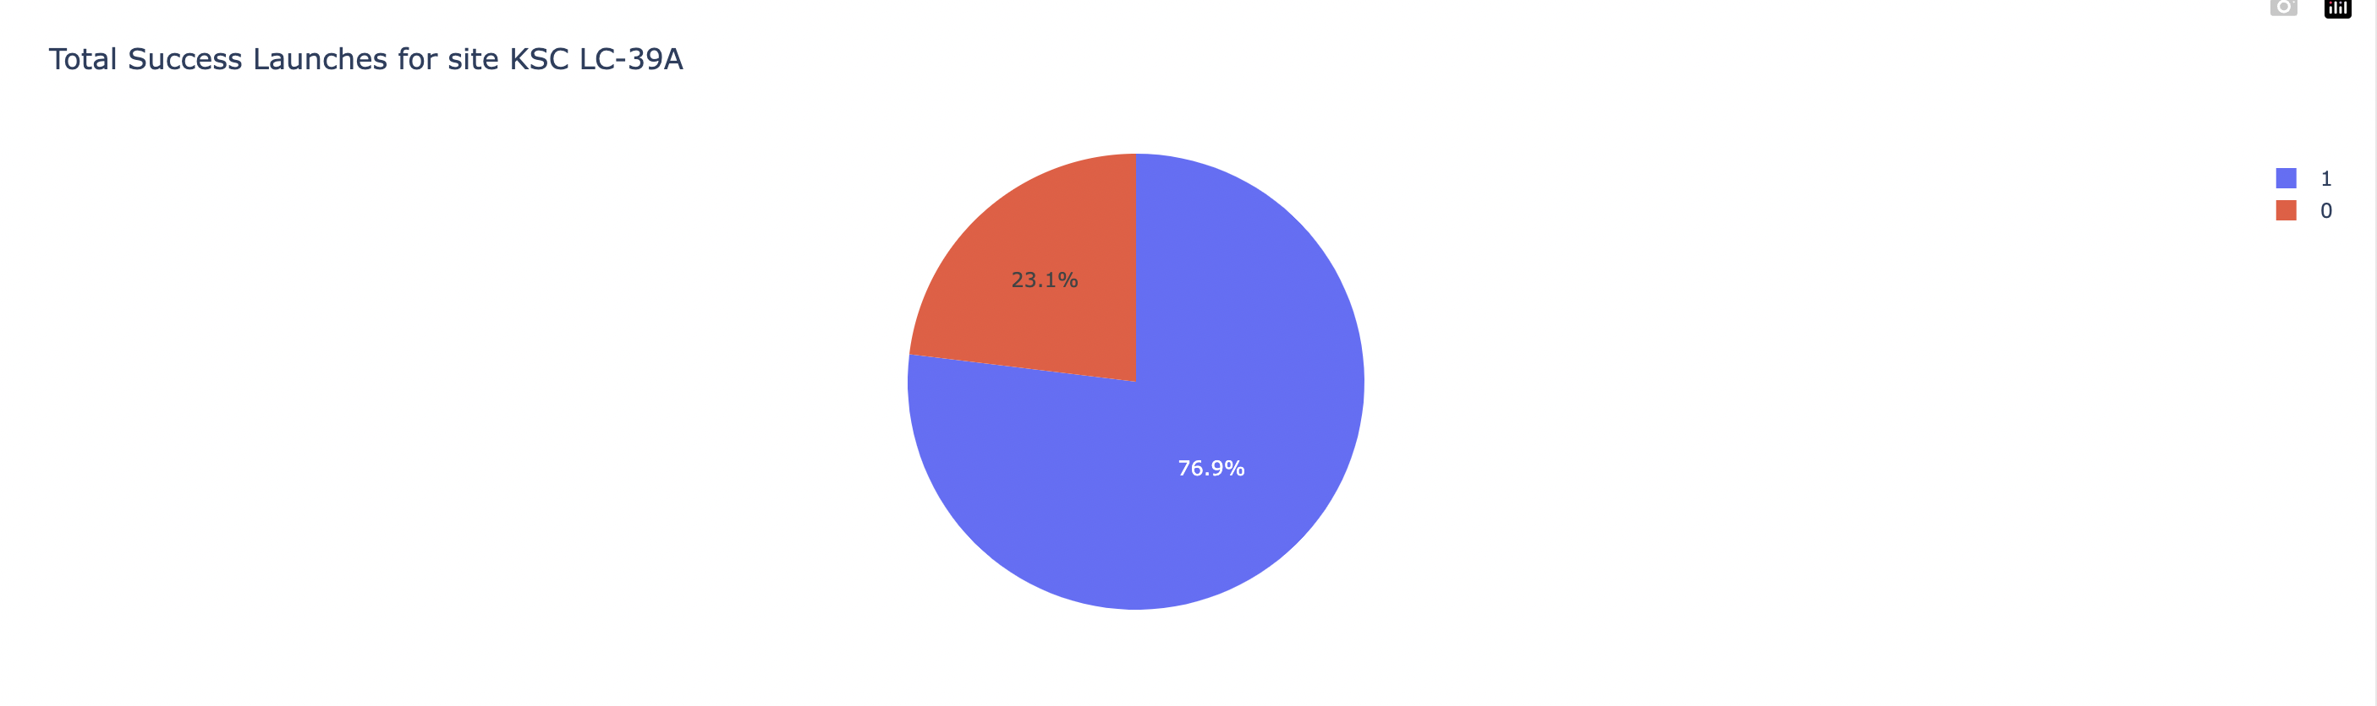
Pie chart showing the Launch site with the highest launch success ratio
KSC LC-39A has 76.9% success rate

Slide 41
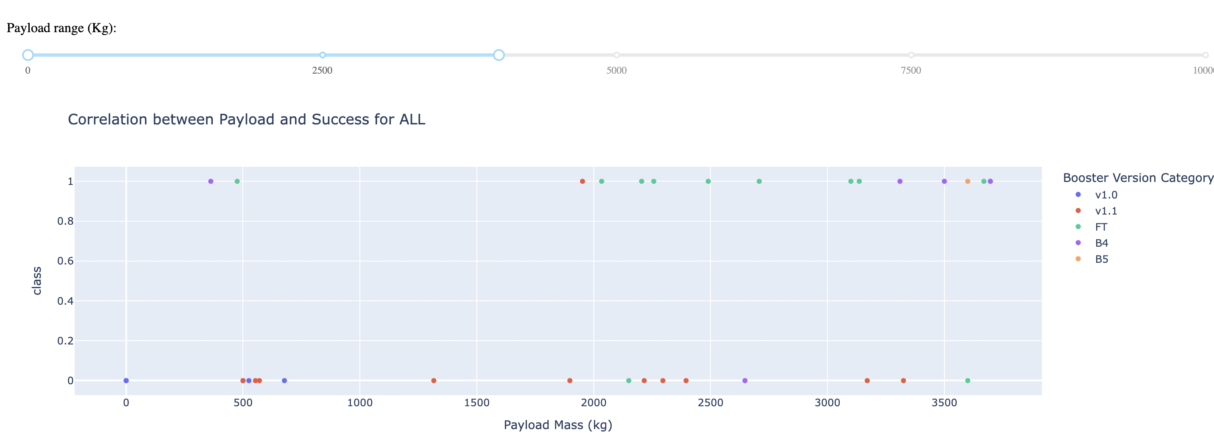
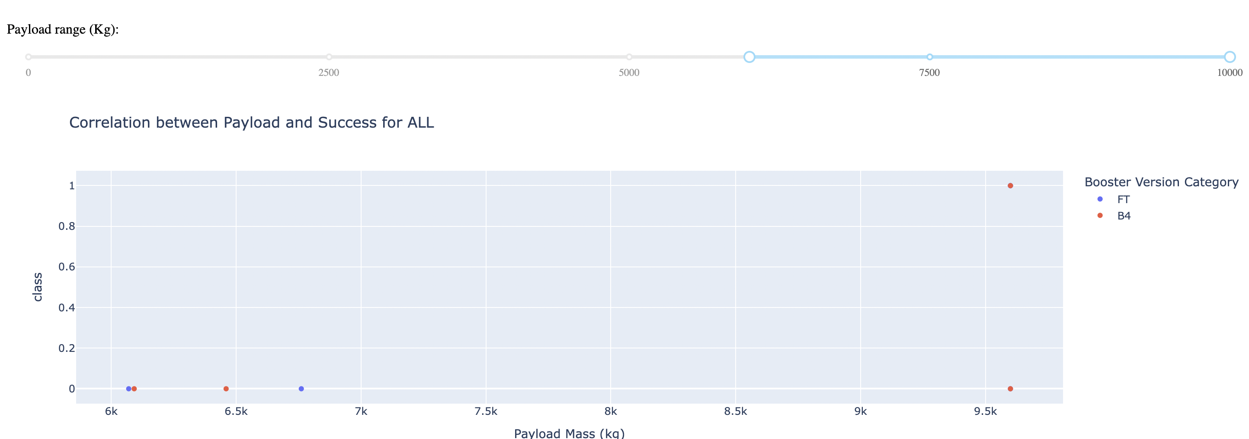
Scatter plot of Payload vs Launch Outcome for all sites, with different payload selected
0-4000kg
6000-10000kg

Slide 42

Section 5

Slide 43
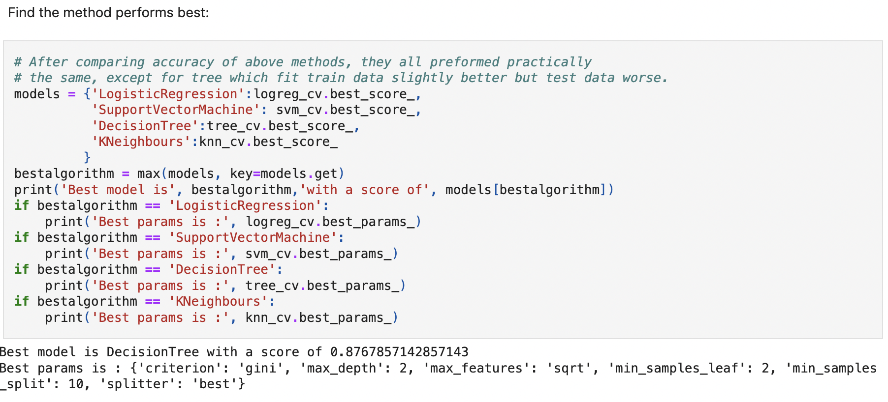
Classification Accuracy
Decision Tree is the model with highest accuracy

Slide 44
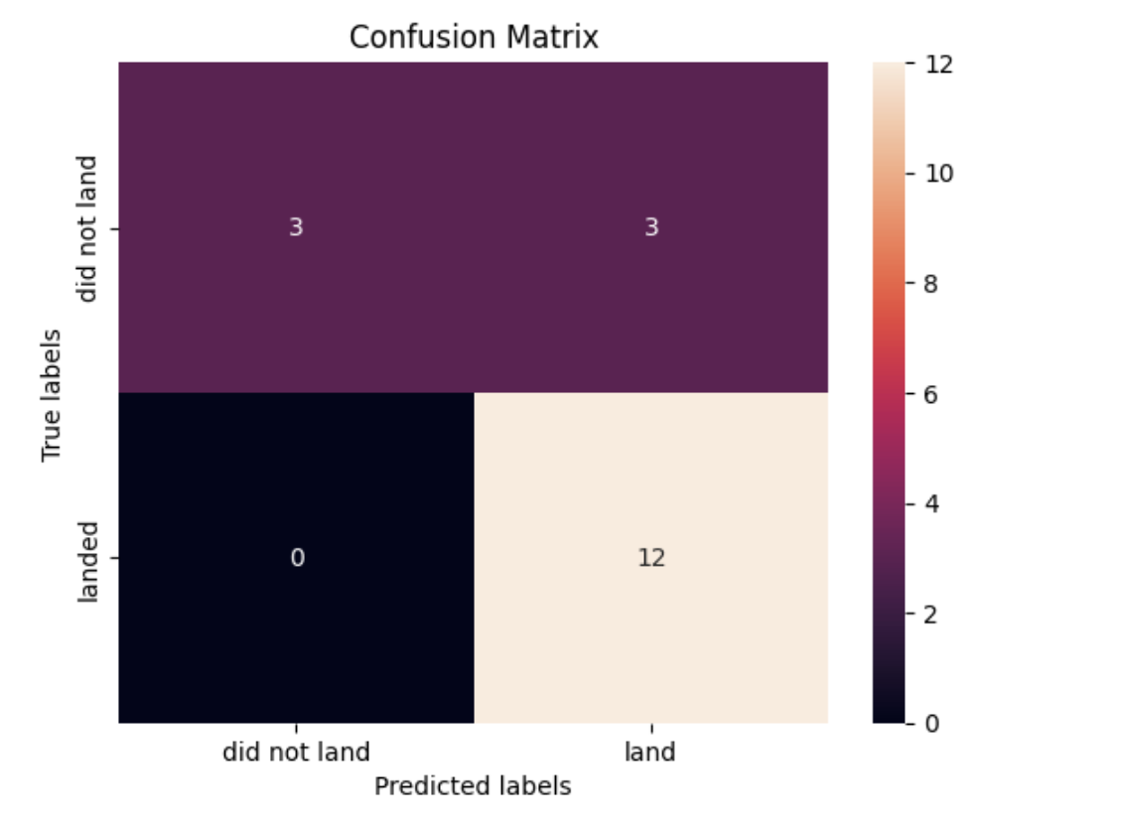
Confusion Matrix
The confusion matrix for the decision tree classifier indicates that the classifier is able to differentiate between different classes. However, a significant issue is the false positives, where unsuccessful landings are incorrectly classified as successful.

Slide 45
Conclusions
We can conclude that: • A higher number of flights at a launch site is associated with a greater success rate at that site. • The launch success rate began increasing in 2013 and continued to rise until 2020. • The orbits ES-L1, GEO, HEO, SSO, and VLEO had the highest success rates. • KSC LC-39A had the most successful launches among all sites. • The Decision Tree classifier is the most effective machine learning algorithm for this task.

Slide 46
Appendix
Include any relevant assets like Python code snippets, SQL queries, charts, Notebook outputs, or data sets that you may have created during this project

Slide 47


